Slide 1
Threat Modeling Digital Credentials: What Could Go Wrong?
2025, June 19th
Simone Onofri (W3C)
simone@w3.org
linkedin.com/in/simoneonofri

Slide 2
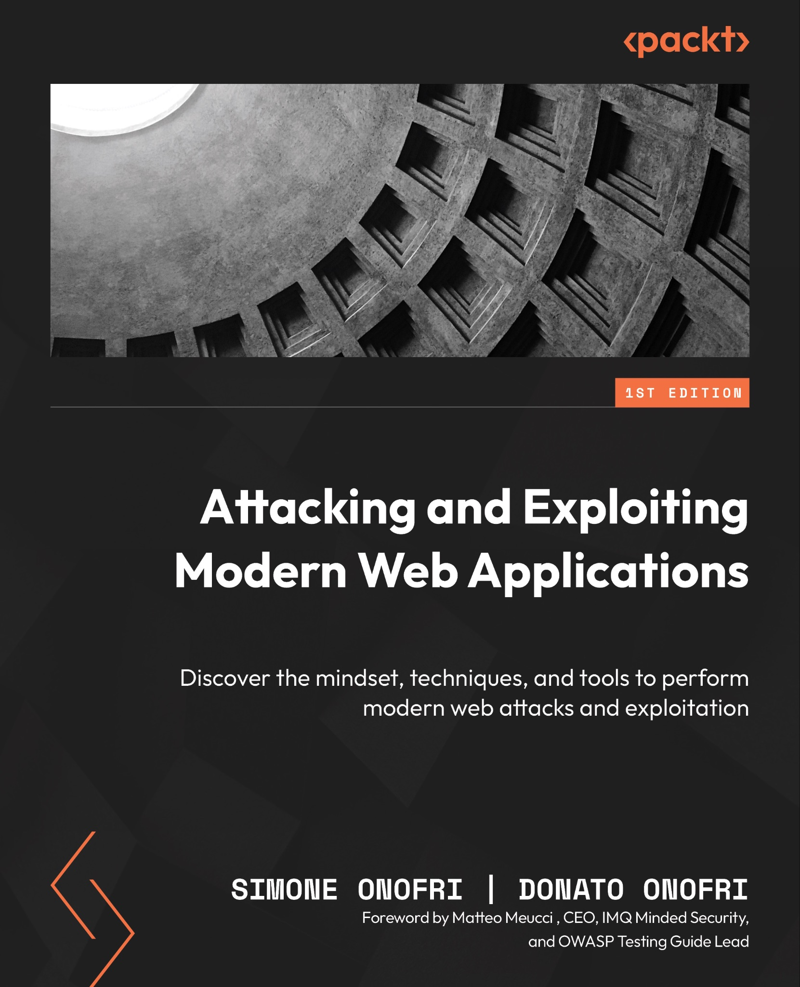
Who am I?
INTRODUCTION
Simone Onofri (Security Lead @ W3C)
I take care of the security of the Web in different ways:
I am the staff contact for supporting the development of security technology in Web Application Security Working Group (CSP, SRI, and more…), Web Authentication Working Group (passwordless authentication), Federated Identity Working Group (Federated and Decentralized Credentials).
I am also reviewing the security of the standardization effort in Security Interest Group, and I’m the co-chair of the Threat Modeling Community Group.

Slide 3
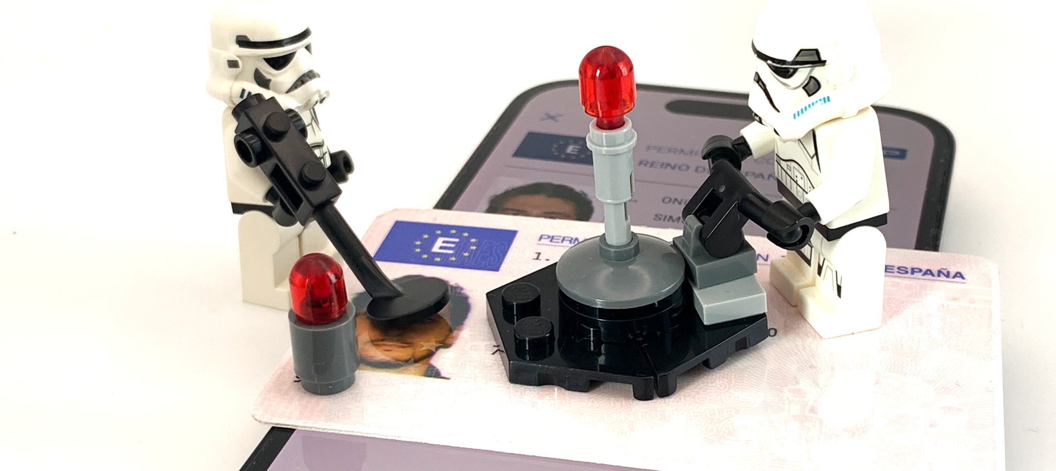
Government-issued Digital Credentials
WHAT ARE WE WORKING ON?

Slide 4


Presenting Digital Credentials on the Web with the Browser API
WHAT ARE WE WORKING ON?
Holder (User)
Acquires, stores, presents Credentials
Verifier
Receives and verifies Presentations
Browser
1. The user clicks the link to submit their presentation to access a resource
Website
Wallet
2. The website requests the presentation of a credential.
5. Credential Verification (another flow)
3. Credential Selection & Presentation preparation (another flow)
4. The browser sends the presentation of the credential
6. The websites grants/denies
the access to the resource

Slide 5
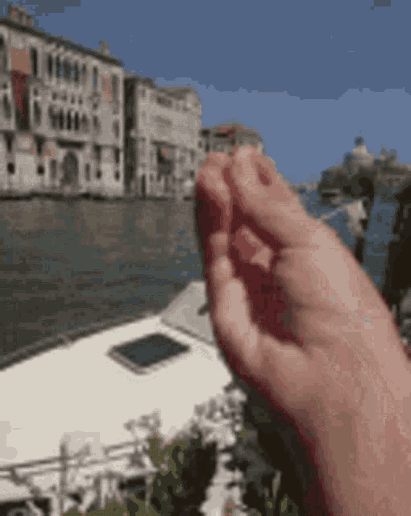
Why we Threat Model?
WHAT ARE WE WORKING ON?
According to the W3C Process, each standard undergoes a wide review (e.g., other SDOs).
During this review, the W3C Guide requires both architectural review and review of horizontal issues related to accessibility, internationalization, security, and privacy.
If a standard is a document that specifies how an API, protocol, file format, etc. should be implemented, then we are in the technology design phase.
What is the best way to think about security at this stage of the development cycle?

Slide 6
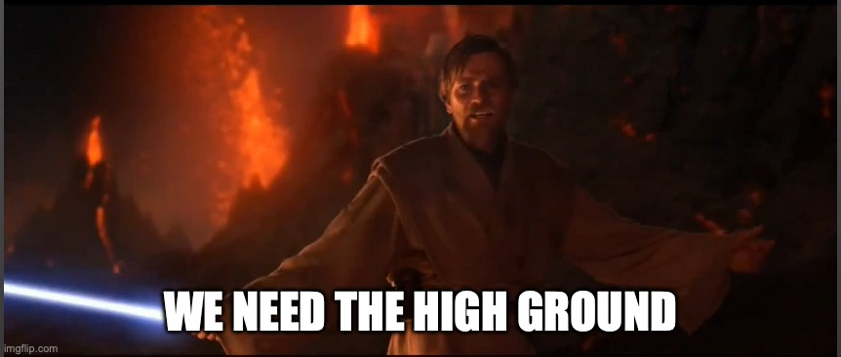

Slide 7
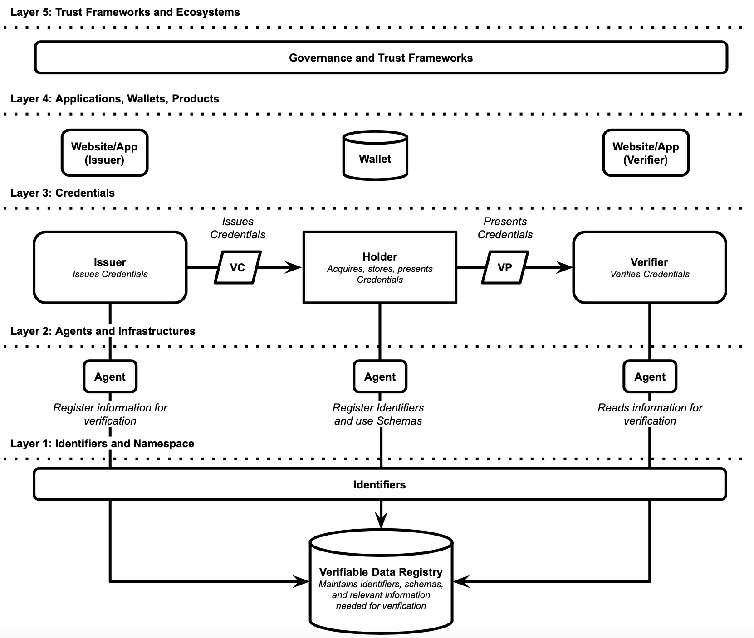
The high-ground Threat Model
WHAT ARE WE WORKING ON?
W3C created an high-level (meta) Threat Model for the Digital Credentials.
The Threat Model has 5 levels:
Layer 5: Trust Frameworks and Ecosystems
Layer 4: Applications, Wallets, Products
Layer 3: Credentials
Layer 2: Agents (not only AI) and Infrastructure
Layer 1: Identifiers and Namespaces (Verifiable Data Registry)
To capture high-level threats type such as the one affecting Human Rights (Harms) and Privacy.

Slide 8
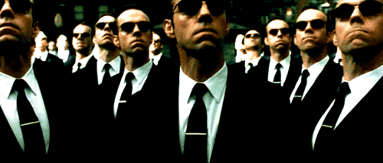

Slide 9
A model with a focus on… presentation (and some standards)
WHAT ARE WE WORKING ON?
Presentation
JOSE
W3C VCDM
COSE
Data Model
mDL
Encoding
Formats/Signature
JSON
CBOR
JWT
ECDSA
DID
JSON-LD
CBOR-LD
SD-JWT
EdDSA
Identifier
BBS
Issuing Protocol
Holder
Presentation Protocol
Issuer
Wallet
Browser
Verifier
(Website)
W3C VC API
W3C VC API
OPENID4VP
DC API
OPENID4VP
Status Update
Bitstring
Credential Verification
Status Information

Slide 10
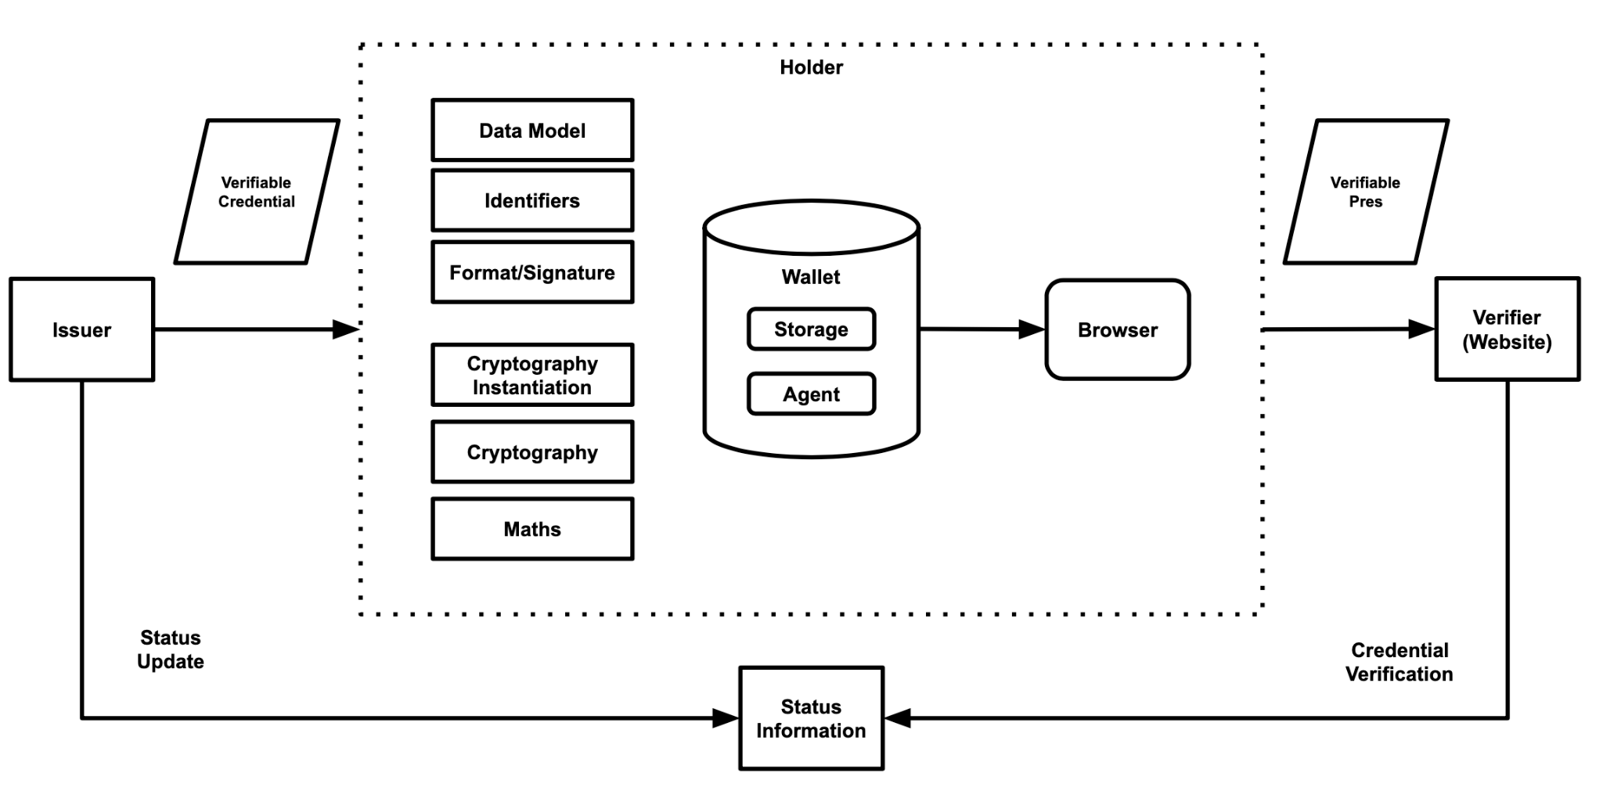
A model with a focus on… cryptographic elements
WHAT ARE WE WORKING ON?

Slide 11
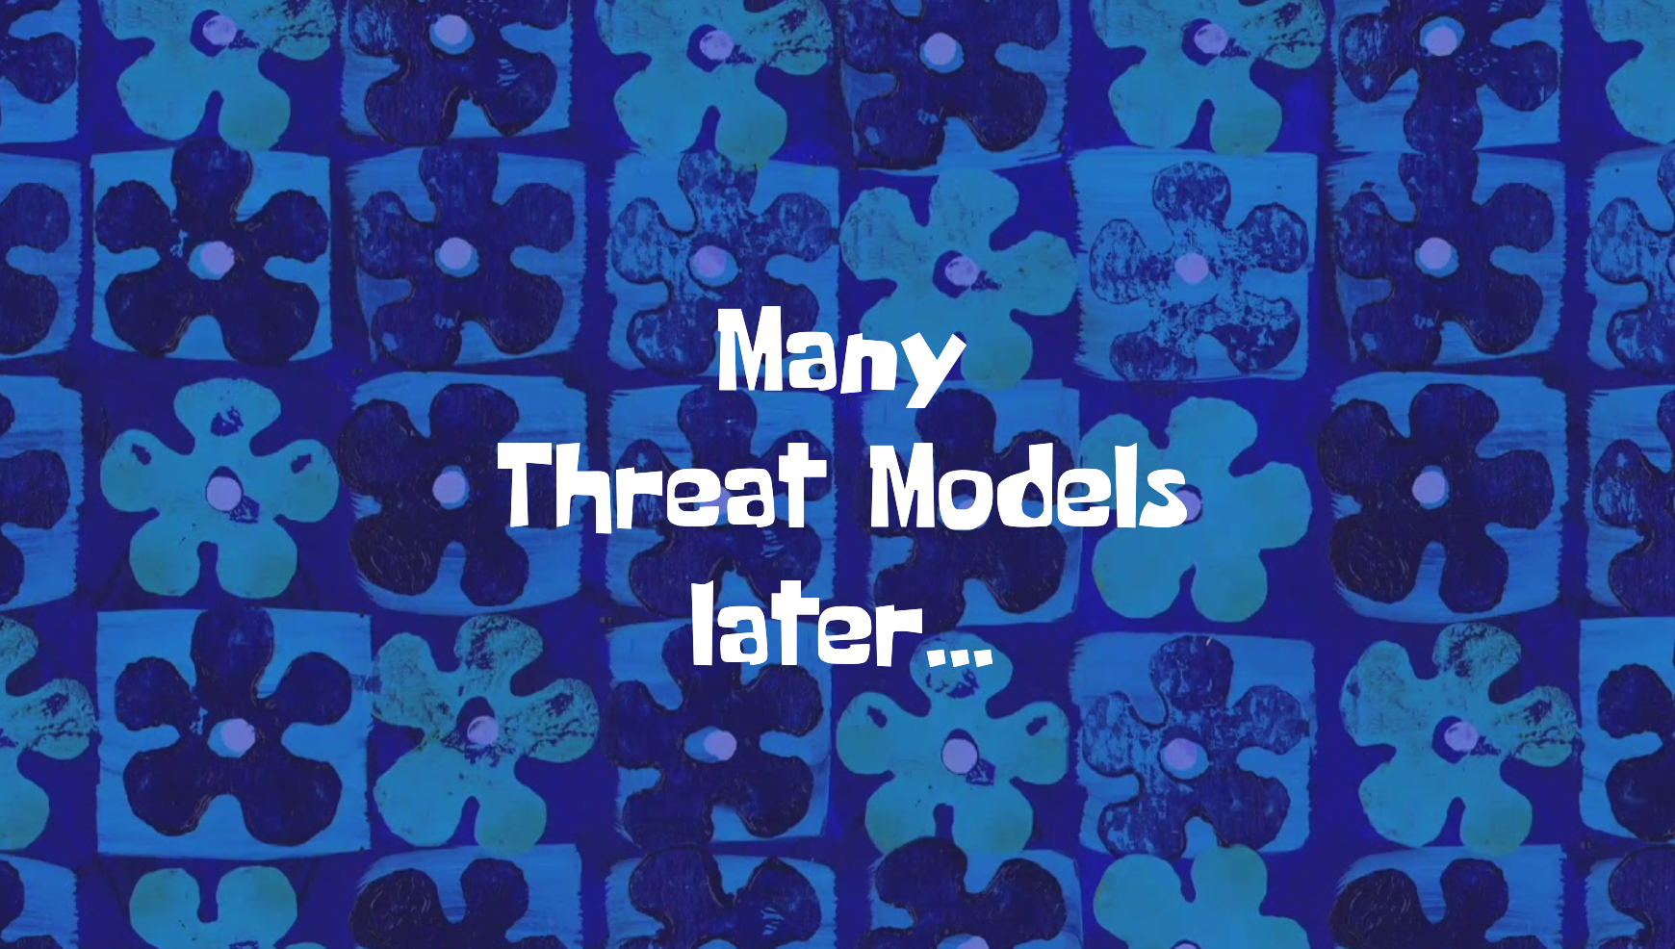

Slide 12
“All models are wrong, but some are useful”
from statistician George Box (1976), quoted by Shostack (2014)

Slide 13
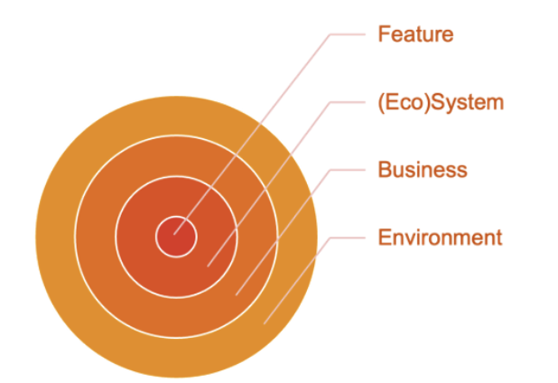
Multi-dimensional Threat Models
WHAT ARE WE WORKING ON?
We can consider Threat Models on different dimensions:
According to the level of detail (e.g., from the ecosystem to the feature)
According to the type of threat (e.g., security, privacy, human rights, sustainability…)
The types of threats can overlap:
Security and privacy are included among human rights
According to OSSTMM v3, privacy is a type of OPSEC control.
Wuyts and Douglen (2024)

Slide 14
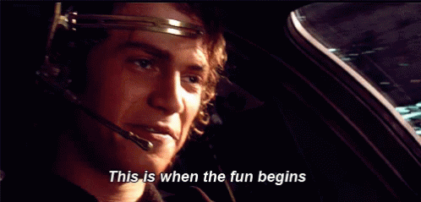

Slide 15
Shostack (2014) described several key points regarding the use of real names and government-issued identities.
“It is tempting to setup a new system that requires people to use their ‘real name’. It is widely believed that a real-name is easier to validate [...] however, the cost of real name requirement is high [...] deferring the issue to identify the users to a government agency is attractive [...] This is a spoofing threat”
In addition to the high-level spoofing threat, we have privacy threats- during the Credentials Verification, the well-known “call home” problem - and human rights threats (harms).

Slide 16
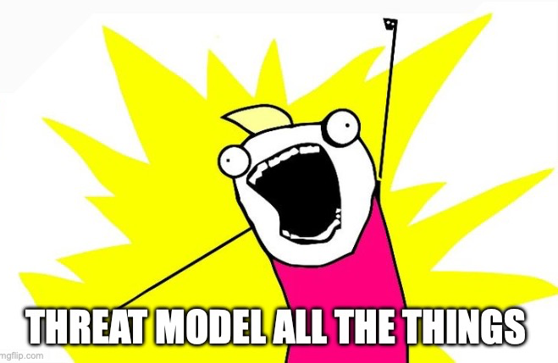

Slide 17
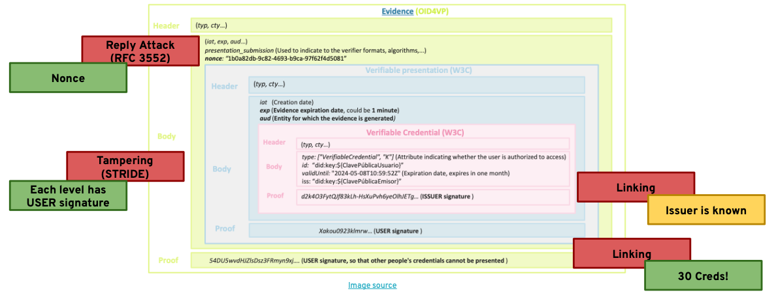
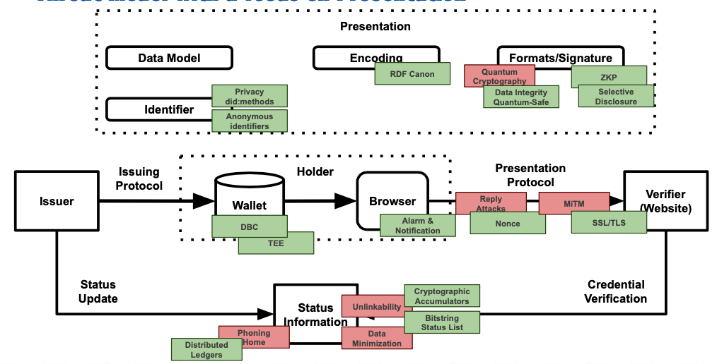
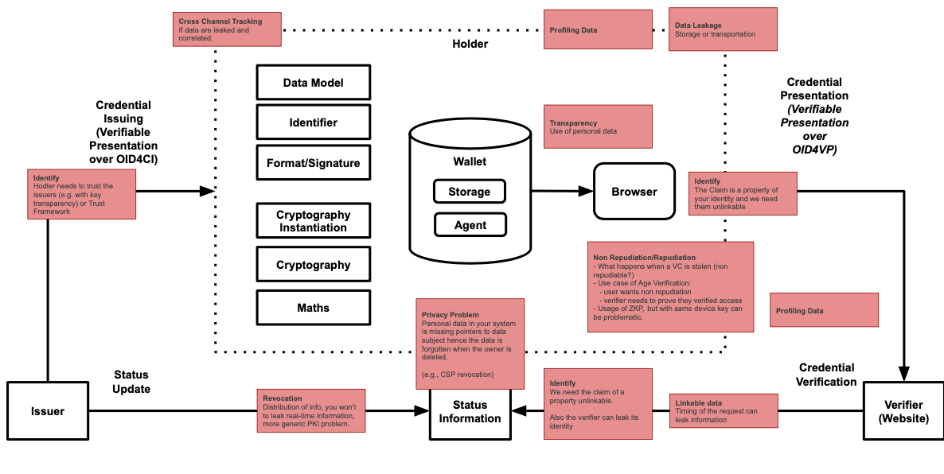
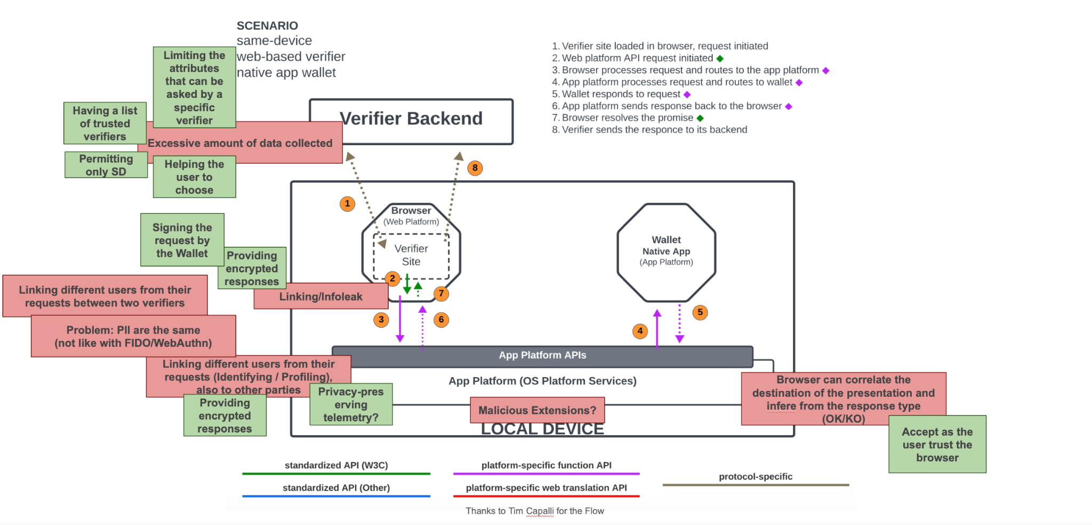
Because all models are wrong…
WHAT CAN GO WRONG?
Presentation Protocol
Presentation v2 (Security*)
Presentation v1 (Privacy*)
Digital Credentials API

Slide 18
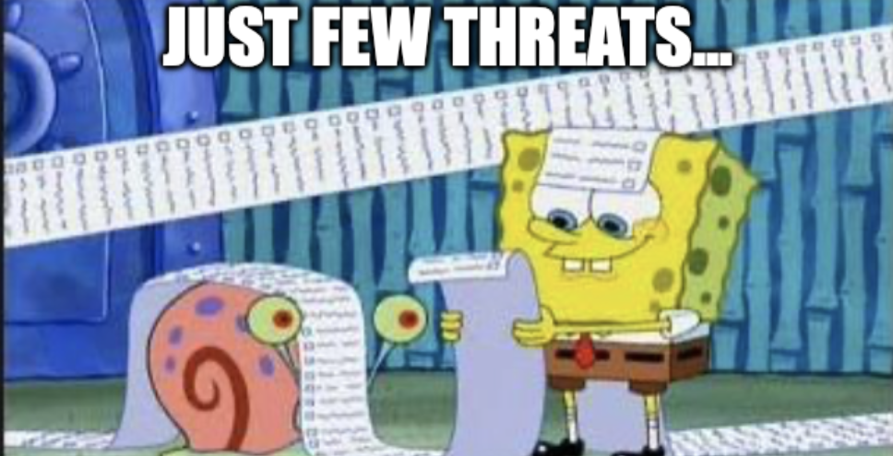

Slide 19
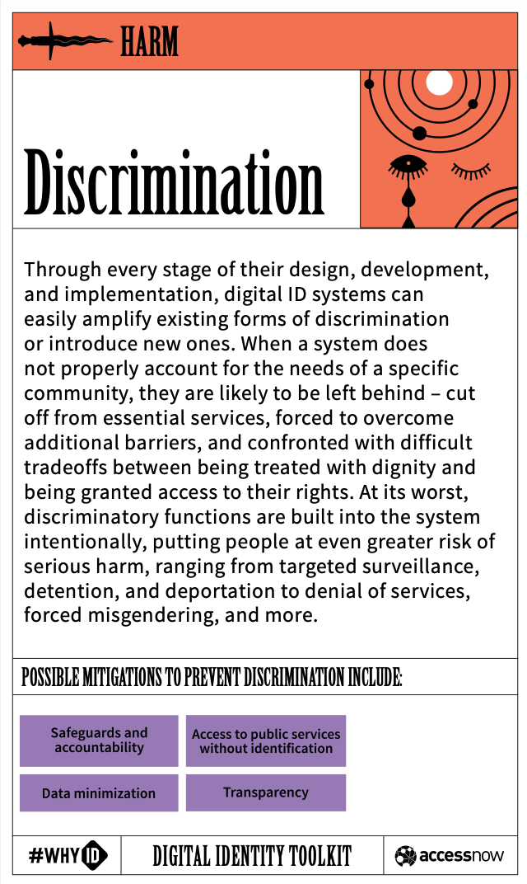
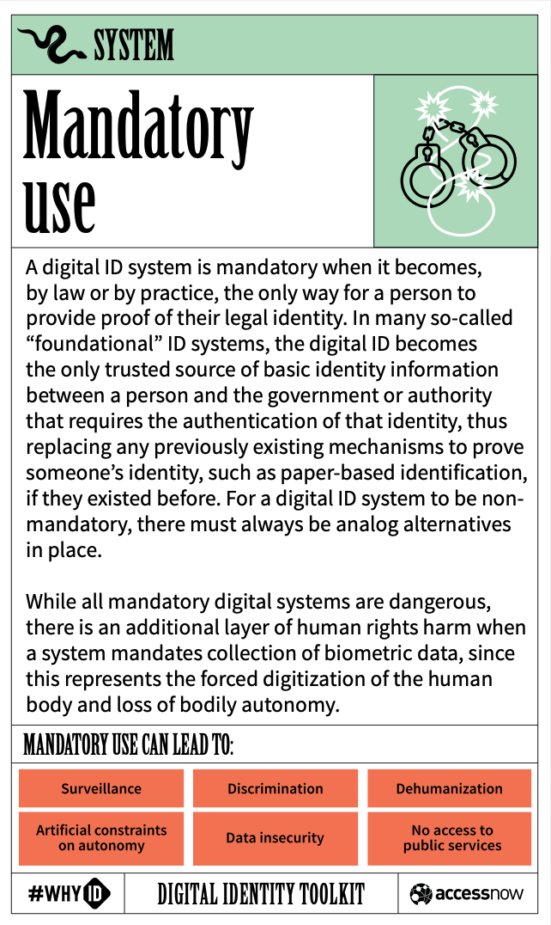
Human Rights/Harms
WHAT CAN GO WRONG?
Some major threats from Microsoft's Responsible Innovation framework and AccessNow’s WhyID
Opportunity loss (Discrimination): Digital divide (e.g., no alternative, need for a specific hardware or software), Interoperability (e.g., cross-border).
Economic loss (Discrimination): Deny opportunities if you do not provide data, or use data to profile.
Dignity loss (Dehumanization): If the vocabulary does not correctly describe people's characteristics.
Privacy Loss (Surveillance): It is necessary to respect the privacy of the users.

Slide 20
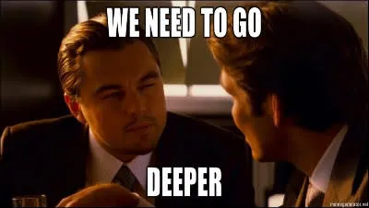

Slide 21
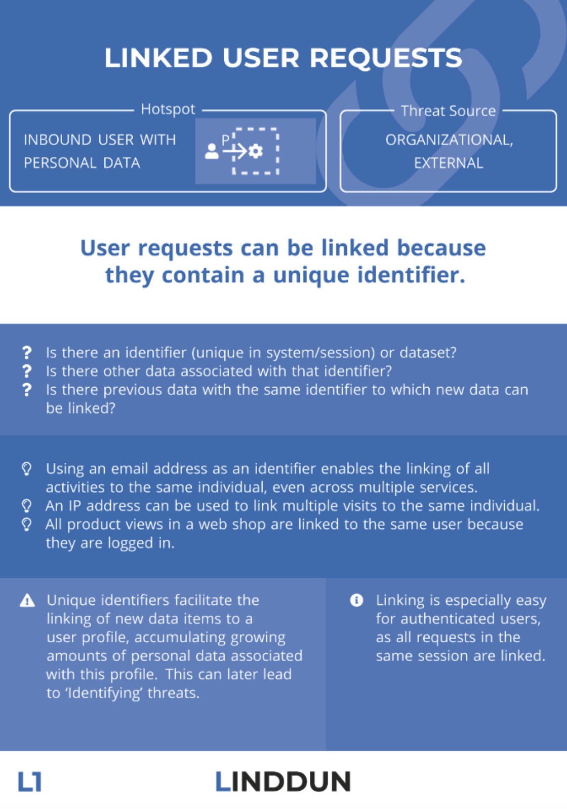
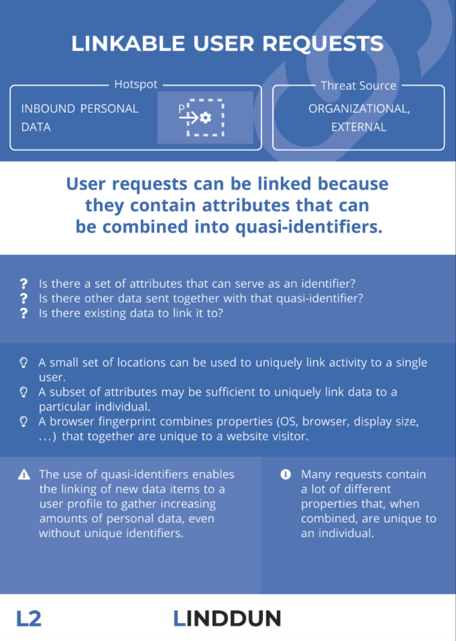
Privacy Requirements (we can derive Threats)
WHAT CAN GO WRONG?
eIDAS 2.0 contains legal requirements, from which it is possible to derive technical requirements:
Selective Disclosure: user can decide to limit the information in a presentation.
Unlinkability: two verifiers should not recognize the same holder, issuer should not know when a credential is presented or verified, even with the collusion of verifier and issuer.
Pseudonymous Authentication: don't use unique identifiers unless necessary.
Non-Transferability: must not use fraudulent or shared credentials.
Mitigations are mainly related to cryptography.

Slide 22
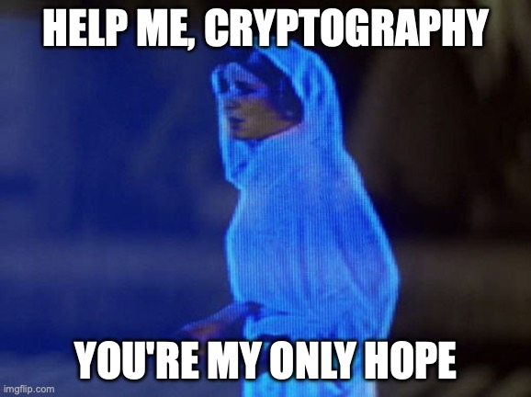

Slide 23
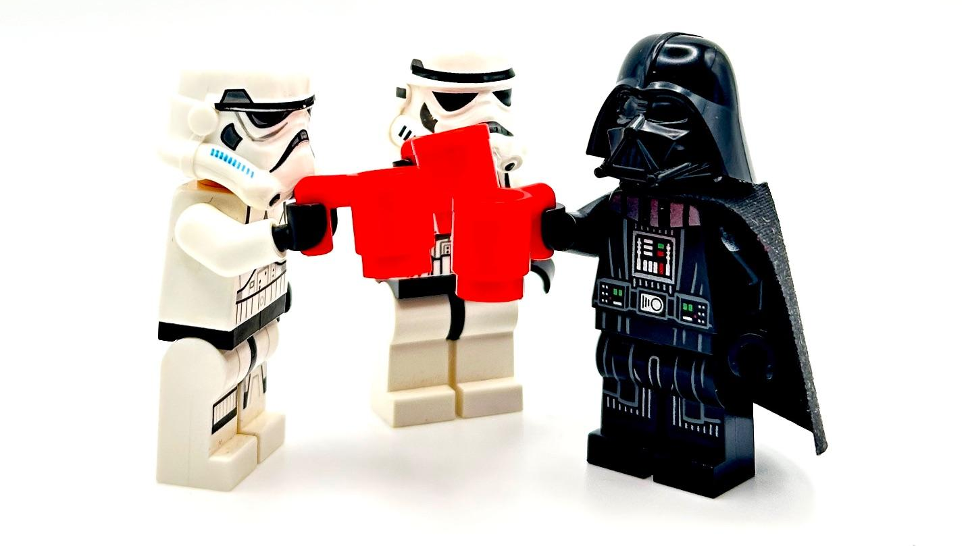
Lessons Learned
DID WE DO A GOOD JOB?
How to combine different Threat Models?
External Security Notes
Security Assumptions
Implementation Requirements
How to put a Threat Model in a Standard?
Make the Threat Model public
Write the Security Considerations Section using the External Security Notes
How to help people to Threat Model?
Providing a Threat Modeling Guide
Providing a Threat List
Providing a boilerplate Threat Model for the Web
Providing a Security and Privacy Questionnaire
Make it fun (e.g., serious games)

Slide 24
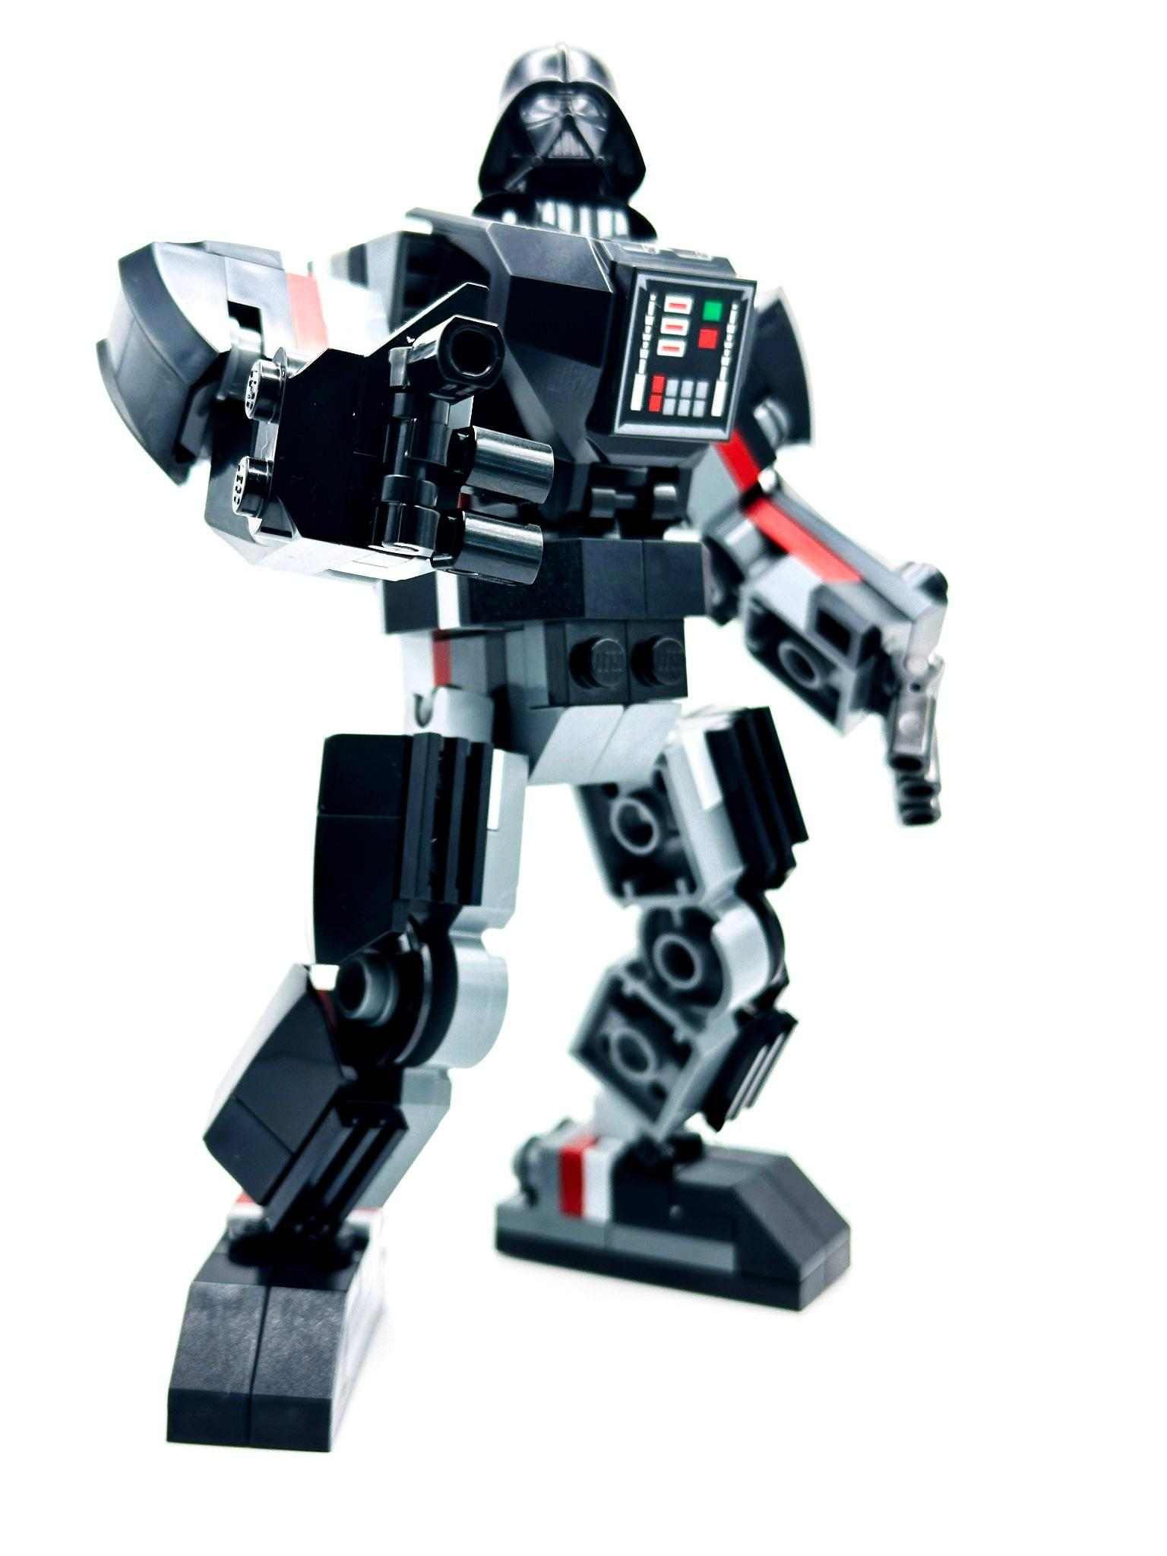
Would you like to help us do a good job?
DID WE DO A GOOD JOB?
If you like to Threat Model, join Threat Modeling Community Group (TMCG)
AI in the Browser/Web
Digital Credentials
Threat Model for the Web
If you like to find vulnerabilities, join Security Interest Group (SING)
Web Authentication
Federated Identity
Web Neural Network API
If you like to help Web Developers to make secure applications, join Security Web Application Guidelines (SWAG)
Checklist also for CRA
In joint with MDN

Slide 25
Simone Onofri (W3C)
simone@w3.org
linkedin.com/in/simoneonofri

